Slide 1
Face Mask Detection Using Yolo
Gavin Jin (jj2915@nyu.edu)
Bernice Feng (bf1318@nyu.edu)

Slide 2
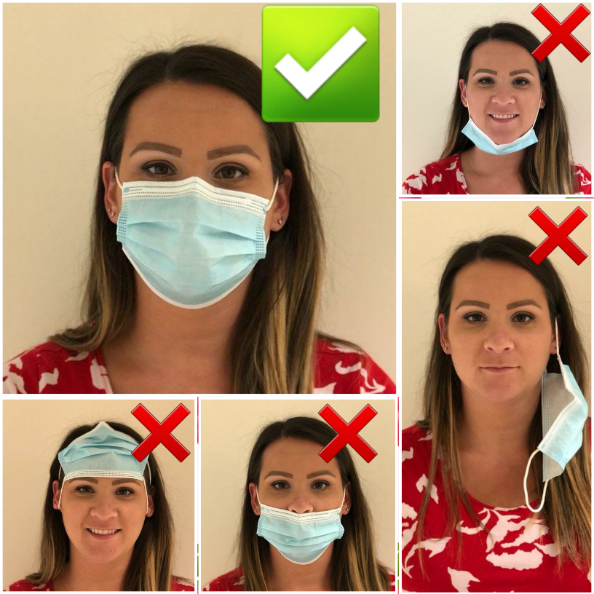
Introduction
Problem:
We would like to run an object detection algorithm to detect whether a person is wearing a mask or not. It is especially interesting to detect if a person is wearing mask correctly, since many people tend to wear incorrectly.
Importance:
As the COVID is still around us, mask is becoming a must in some situations. Such a detection algorithm may be helpful for some facilities to ensure a mask-requirement.

Slide 3
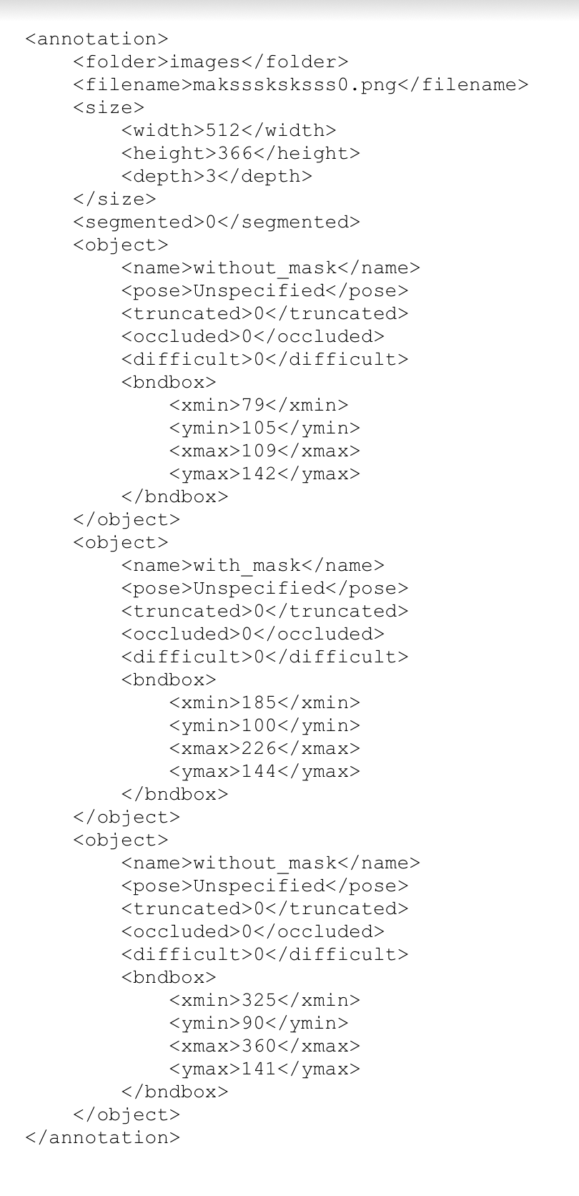
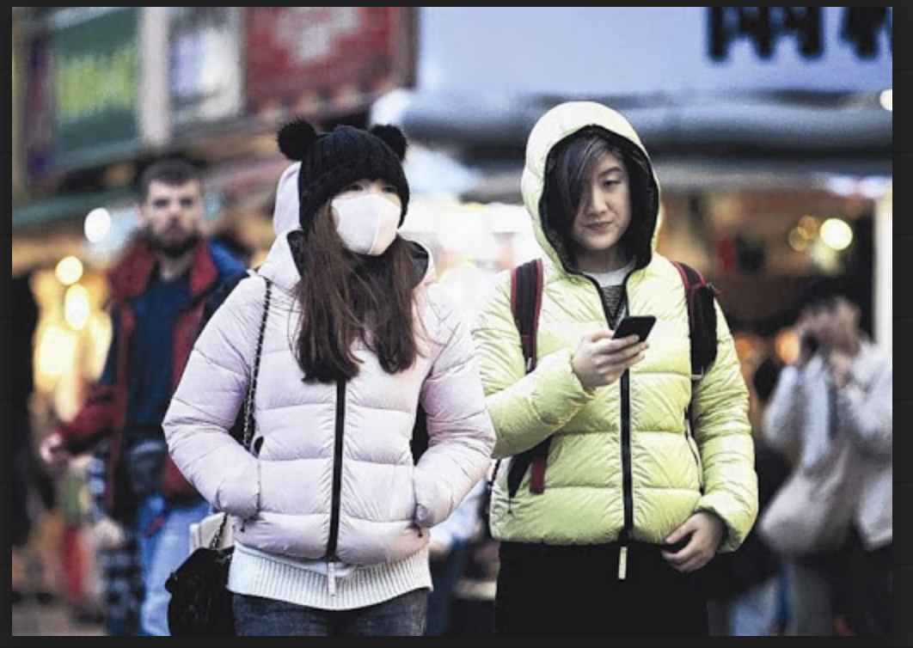
Dataset
Data link: https://www.kaggle.com/datasets/andrewmvd/face-mask-detection
Consist of: 853 images with xml annotations belonging to 3 classes
With mask
Without mask
Mask worn incorrectly
Train set: 767 images (~90%)
Test set: 86 images (~10%)

Slide 4
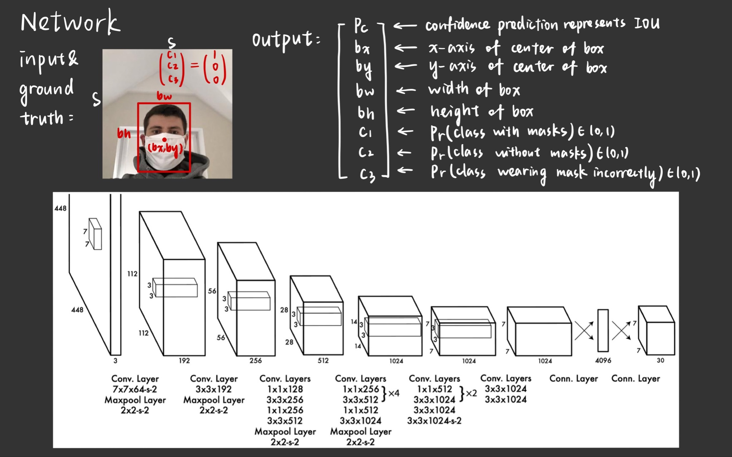

Slide 5
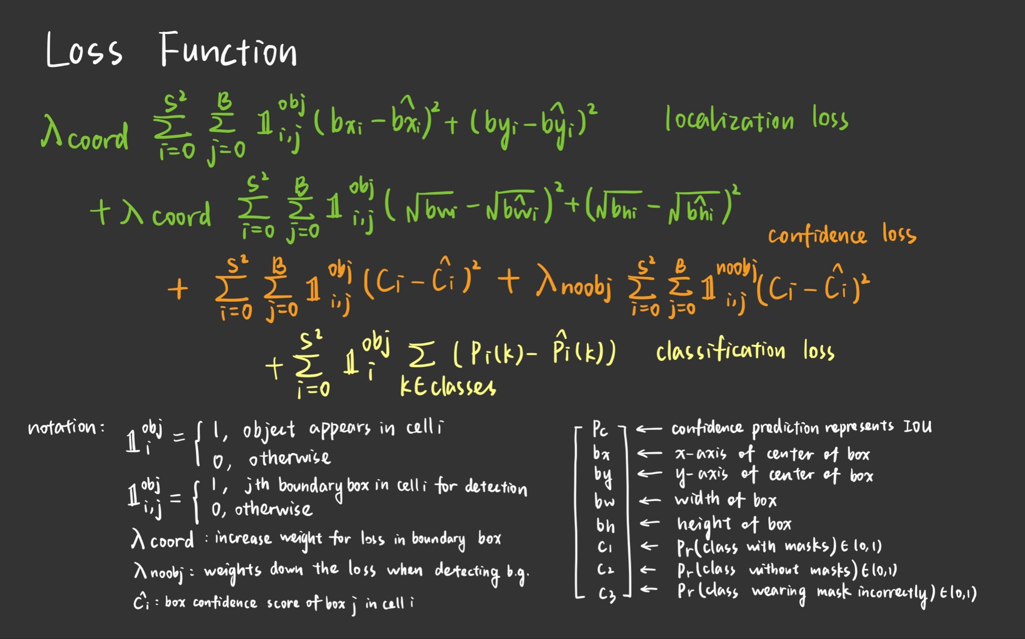

Slide 6
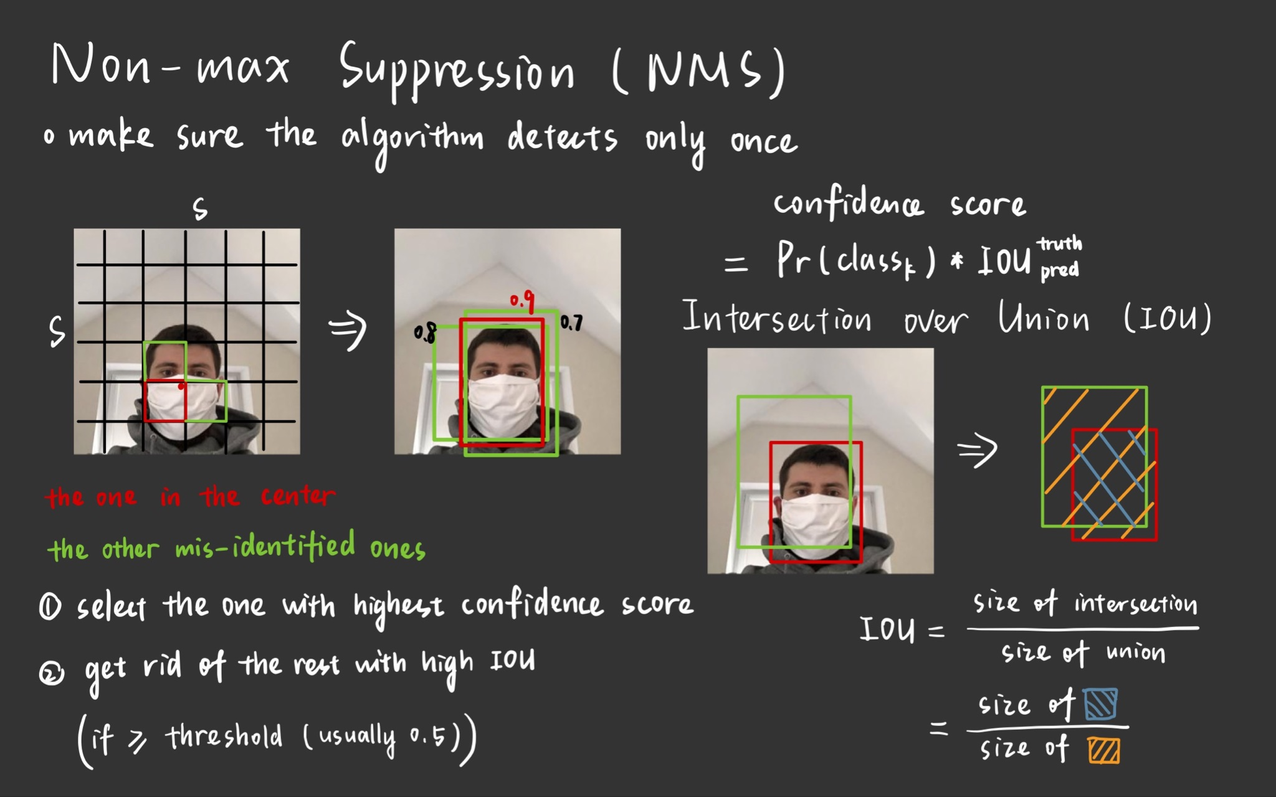

Slide 7
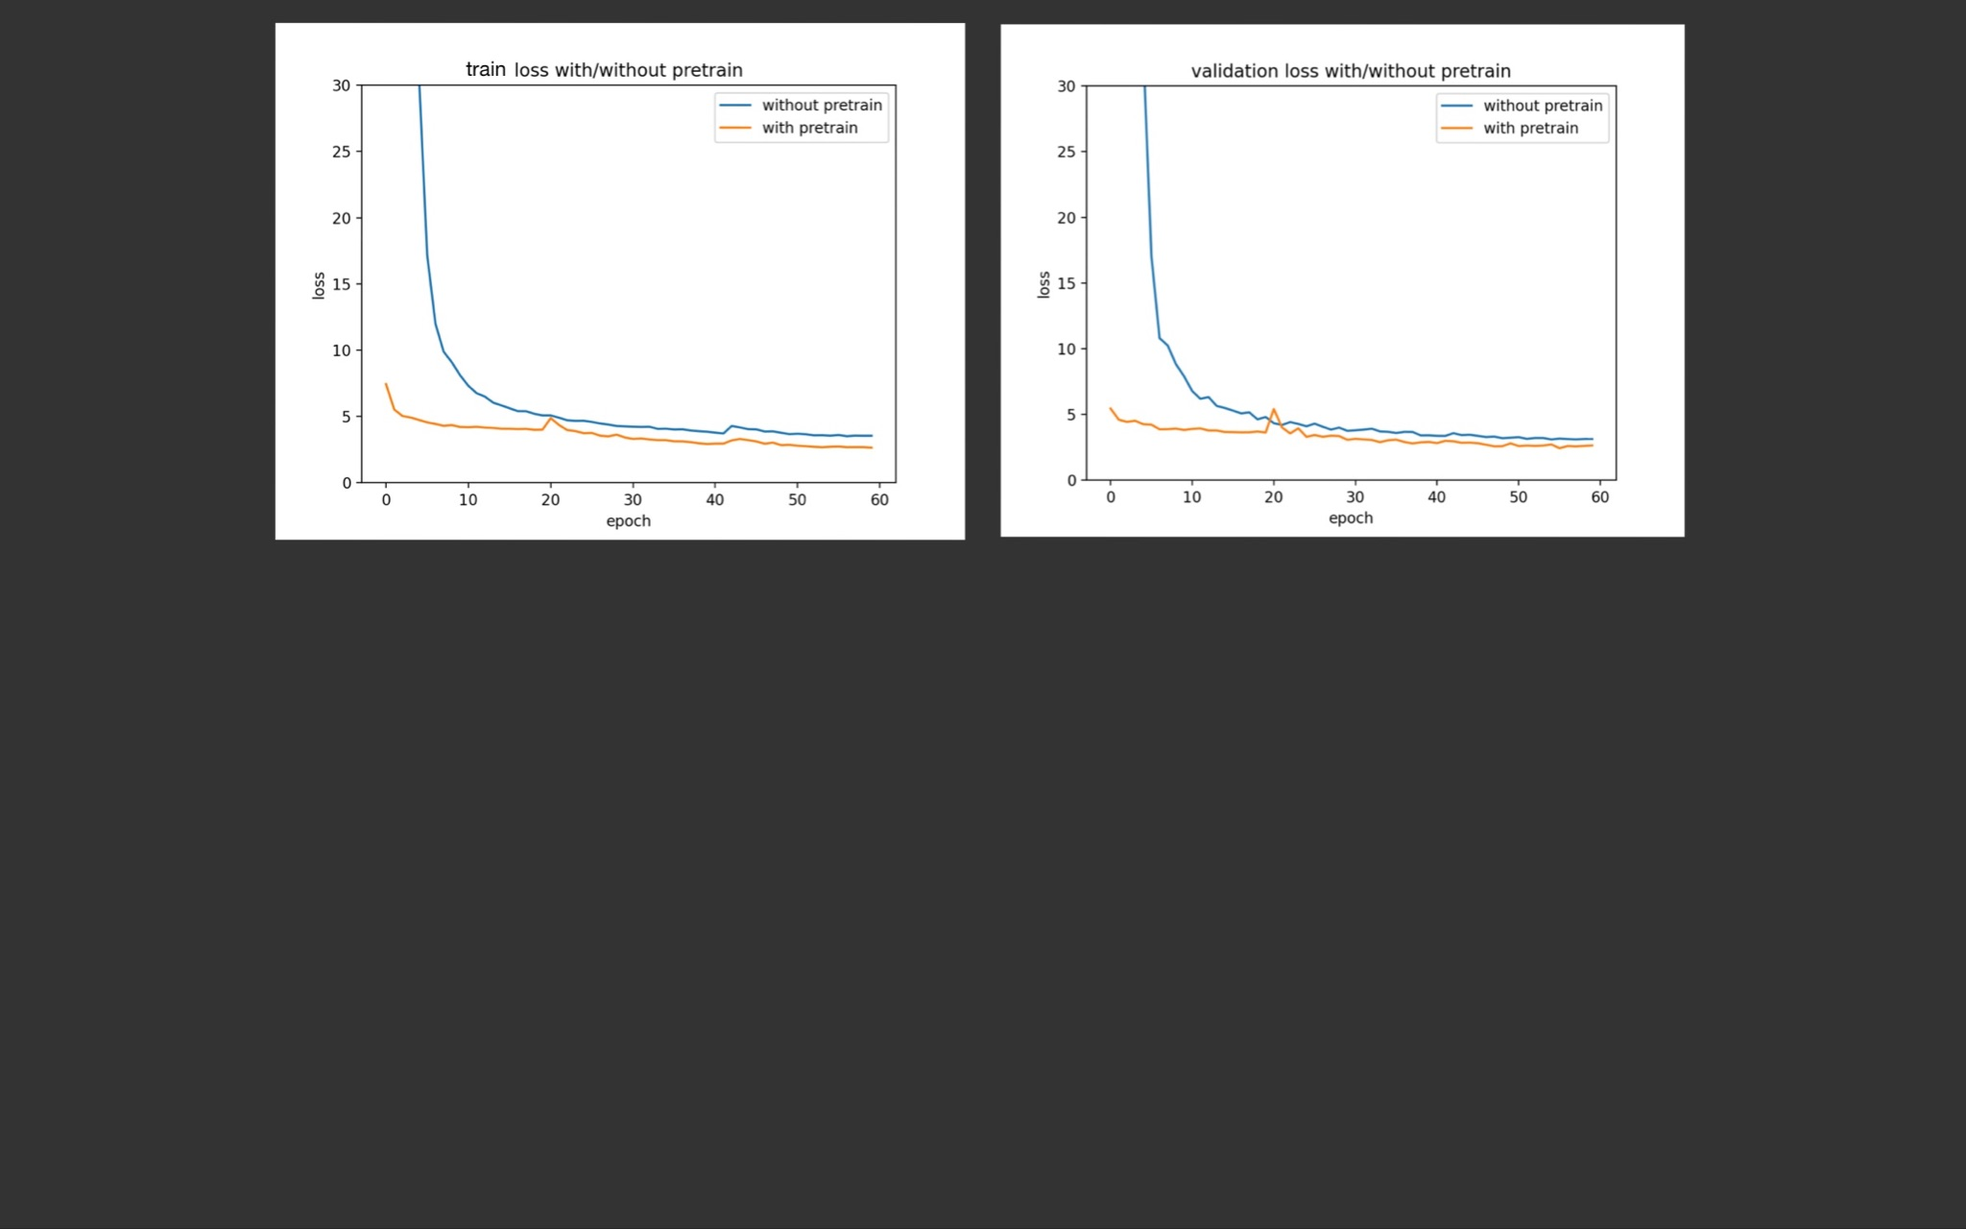
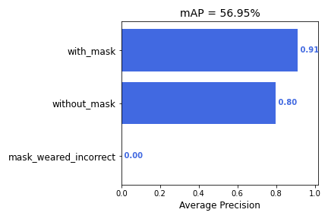
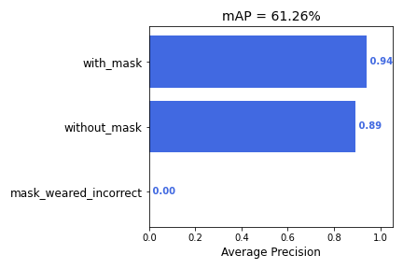
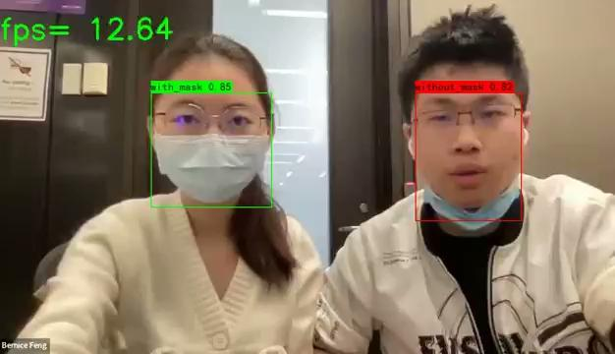
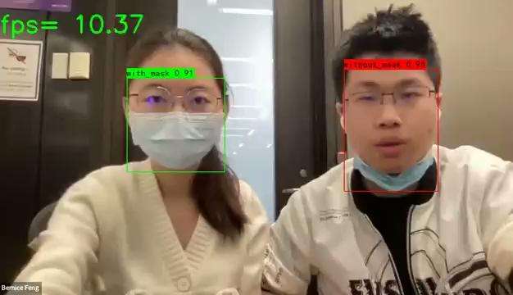

Slide 8
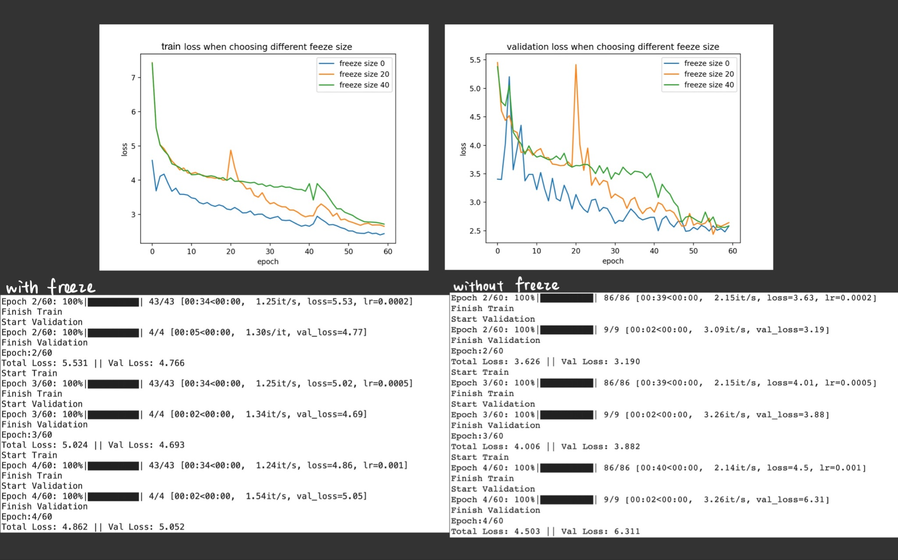
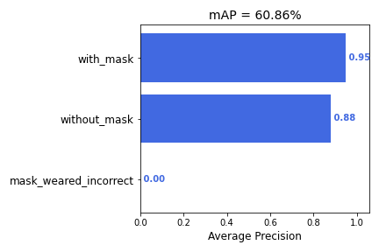
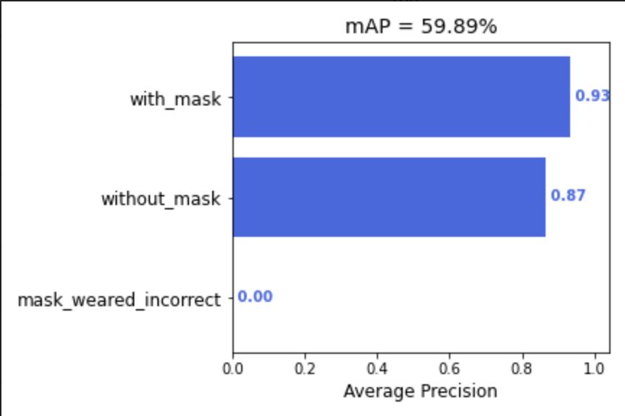

Slide 9
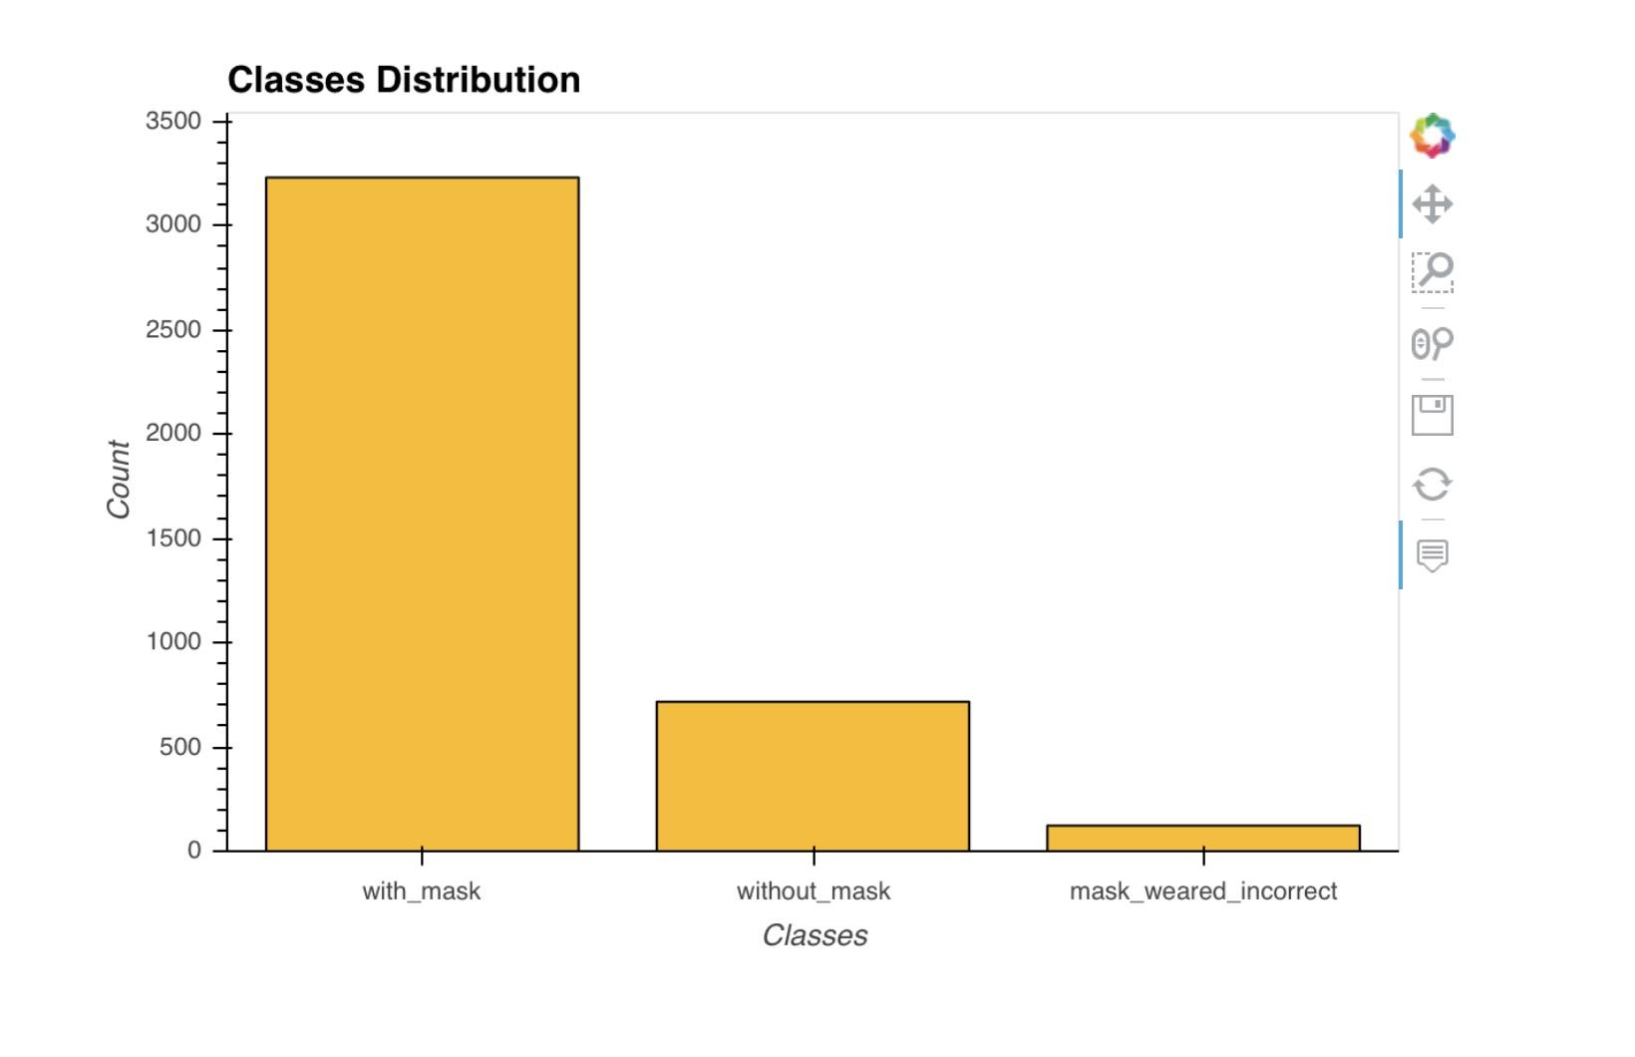
Future Extensions
Our model does not perform well on our dataset, since it is does not have a relative even distribution on each class. We could do data augmentation and better split the dataset to make our train/test set less biased.
Yolo has several upgraded version, each incorporating new techniques to the original model. We could try it out see how the add-ons increase the performance of our network,

Slide 10
Reference
https://arxiv.org/pdf/1506.02640.pdf
https://jonathan-hui.medium.com/real-time-object-detection-with-yolo-yolov2-28b1b93e2088

